Slide 1


By the Pings design and development team
Development team: Rodrigo Juan Guillermo Daniel

Slide 2
Contents table
Introduction
Project Definition
Conceptual and Visual Design of the Interaction
Conclusions

Slide 3
Contents table
Introduction
1.1 Definition of the problem
1.2 Motivation
Project Definition
Conceptual and Visual Design of the Interaction
Conclusions

Slide 4

Introduction
Definition of the problem:
Develop web software project.
Management of private transport.
Provide information.
User management and interaction.
Payment gateway.

Slide 5
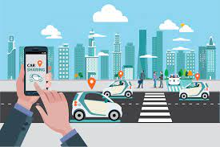
Introduction
Motivation:
Facilitate mobility.
Eco friendly environment.
Optimize private transport.

Slide 6
Contents table
Introduction
Project Definition
2.1 Goals
2.2 Scope of the Project
2.3 Project Subsystems
Conceptual and Visual Design of the Interaction
Conclusions

Slide 7
Project Definition
Goals:
Riders and drivers should be able to register in the app
Drivers should be able to post rides, going into and out of the uam
Bookings should be possible, and cancellations
All payments should be made through the app

Slide 8

Project Scope
Deliver a service as means of communication, management and storage. The project will not include:
Private GPS-System
In-app calls
Bonification credits/status
Customer support (consultory and liveline)

Slide 9

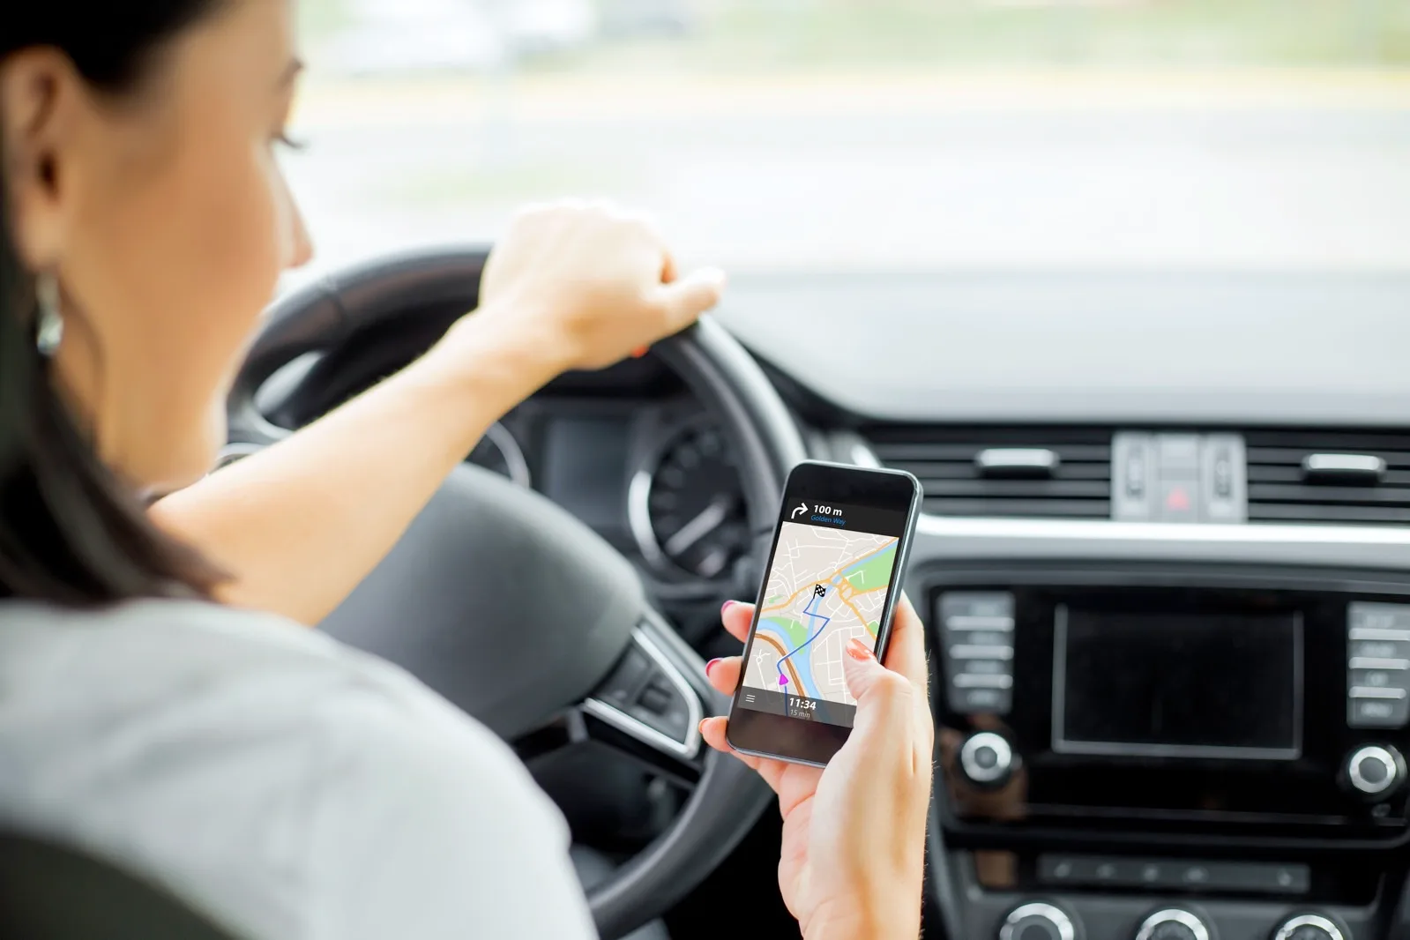
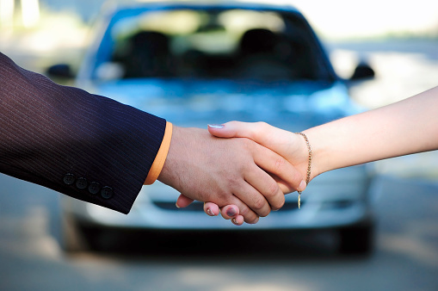
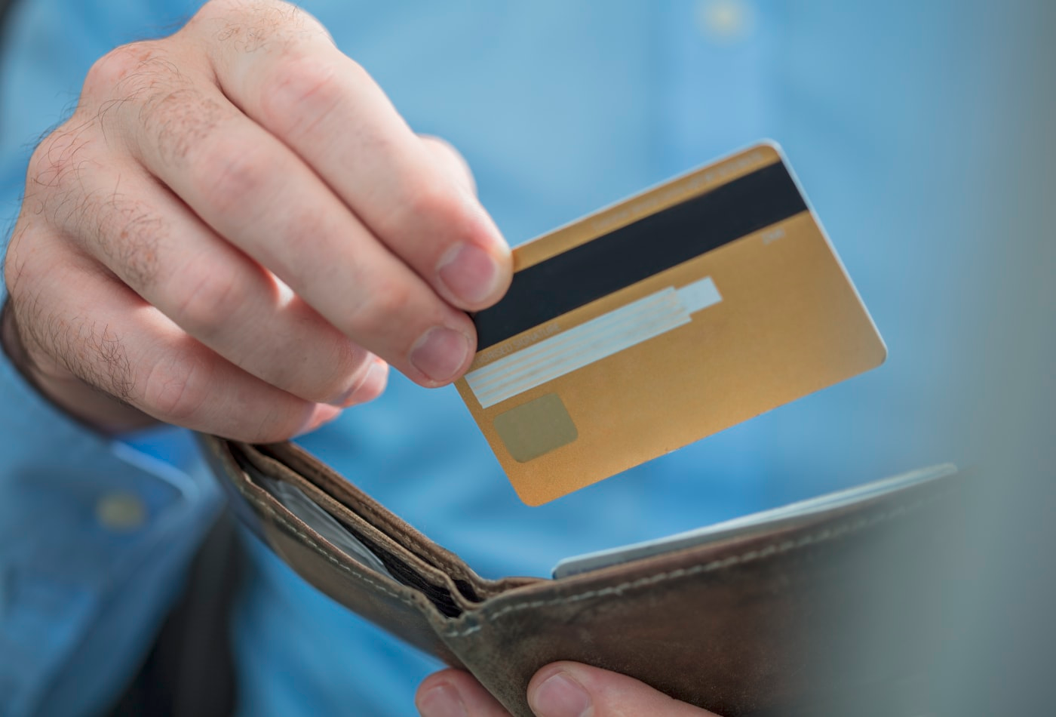
Project Subsystems
User Management
Ride Publication
Ride Booking
Virtual Payment

Slide 10
Contents table
Introduction
Project Definition
3. Conceptual and Visual Design of the Interaction
3.1 Login
3.2 Map
3.3 Rides
3.4 Settings
3.5 Payment
4.Conclusions

Slide 11
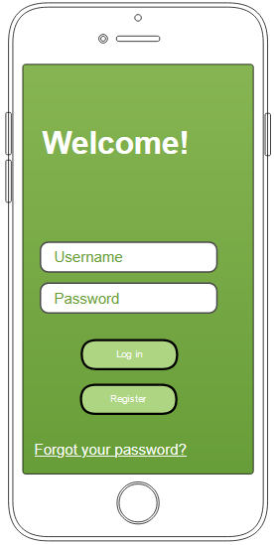
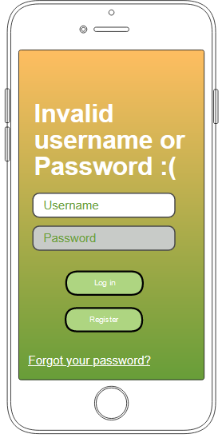
Login Page

Slide 12
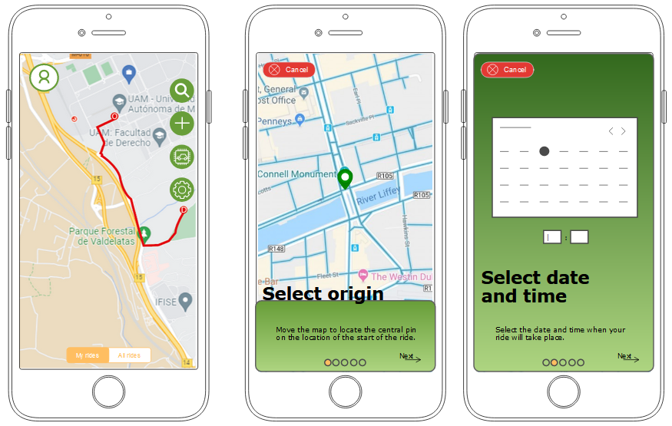
Map

Slide 13
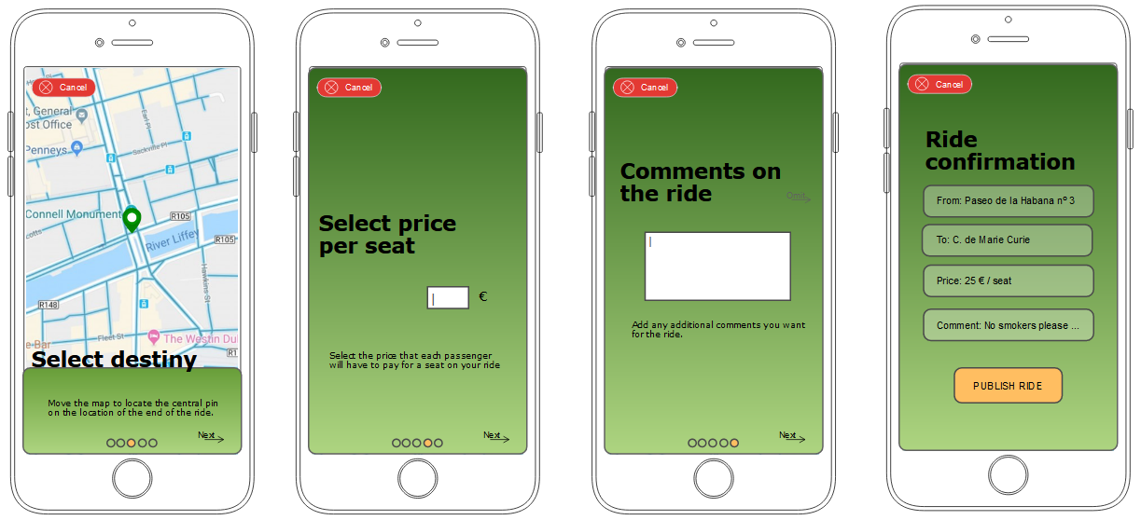
Rides

Slide 14
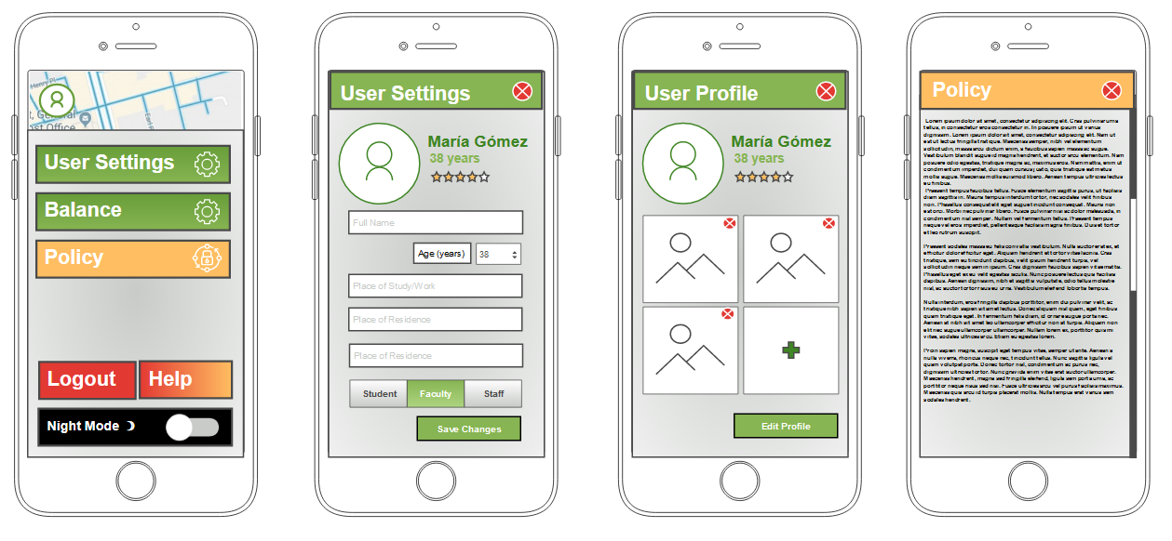
Settings and User Profile

Slide 15
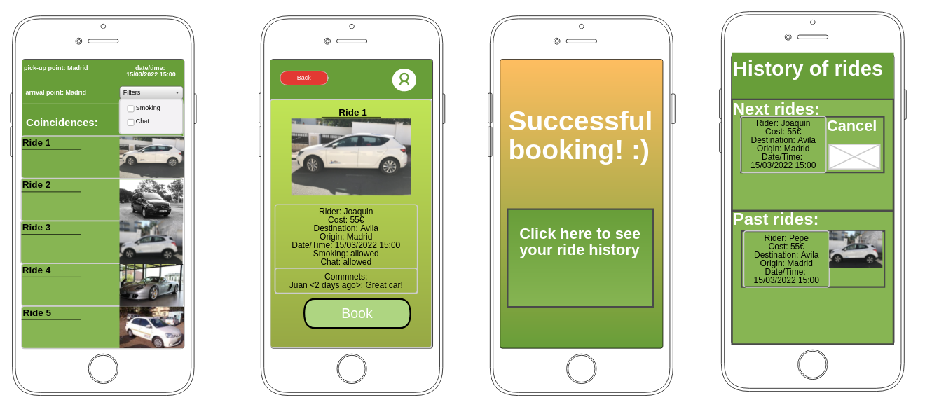
Rides

Slide 16
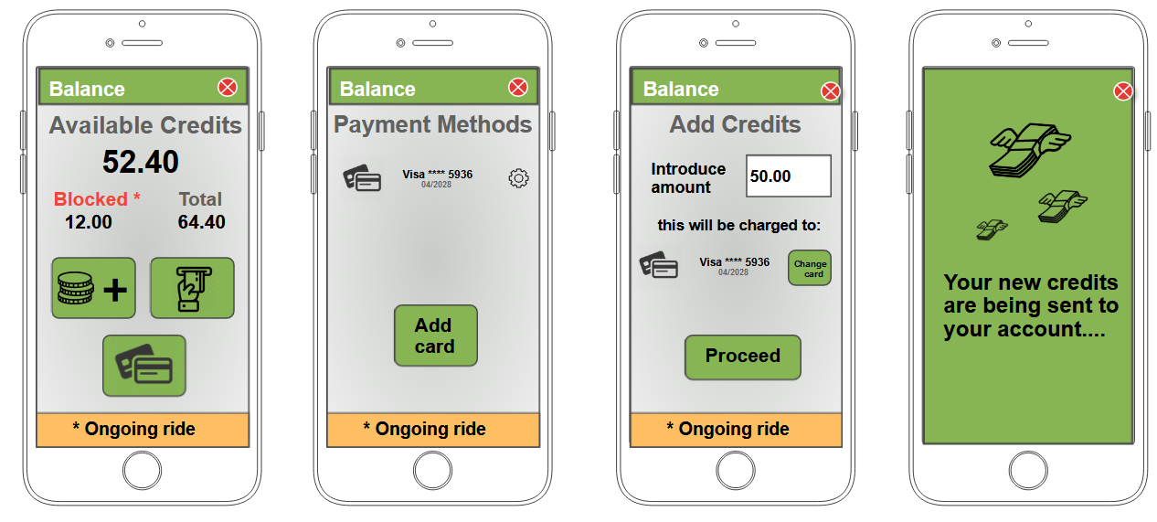
Payment

Slide 17
Contents table
Introduction
Project Definition
Conceptual and Visual Design of the Interaction
Conclusions
4.1 Unfeasible features
4.2 Future features
4.3 Conclusions

Slide 18

Unfeasible features
Private GPS-System
In-app calls
Bonification credits/status
Customer support (consultory and liveline)

Slide 19

Future features
Share location
Eco stats
Reserve a recurring trip
Chat with drivers

Slide 20

Conclusions
Common goal
Gain consciousness about the problem
Allow UAM staff to join and share rides
Reduce carbon footprint

